Slide 1

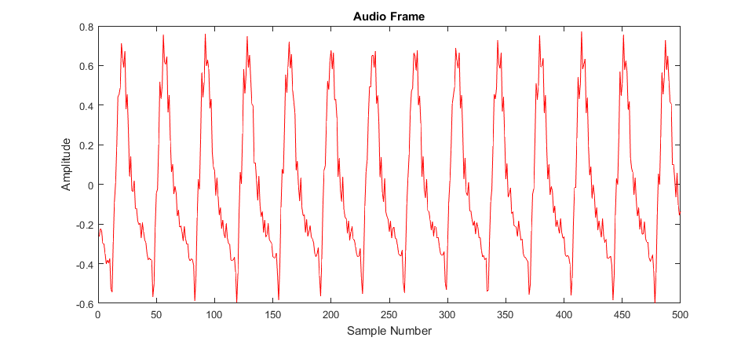
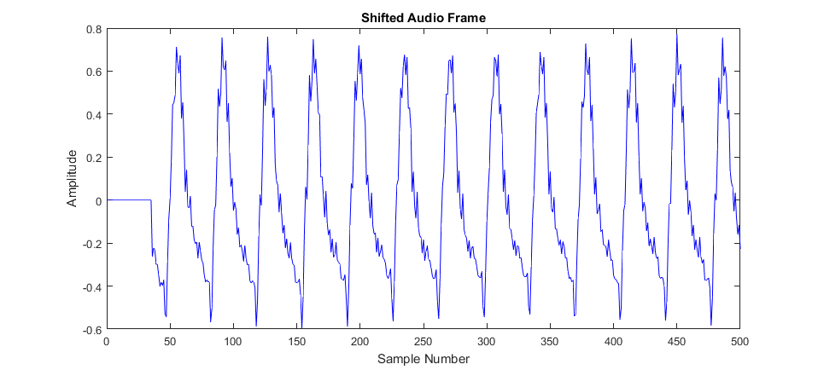
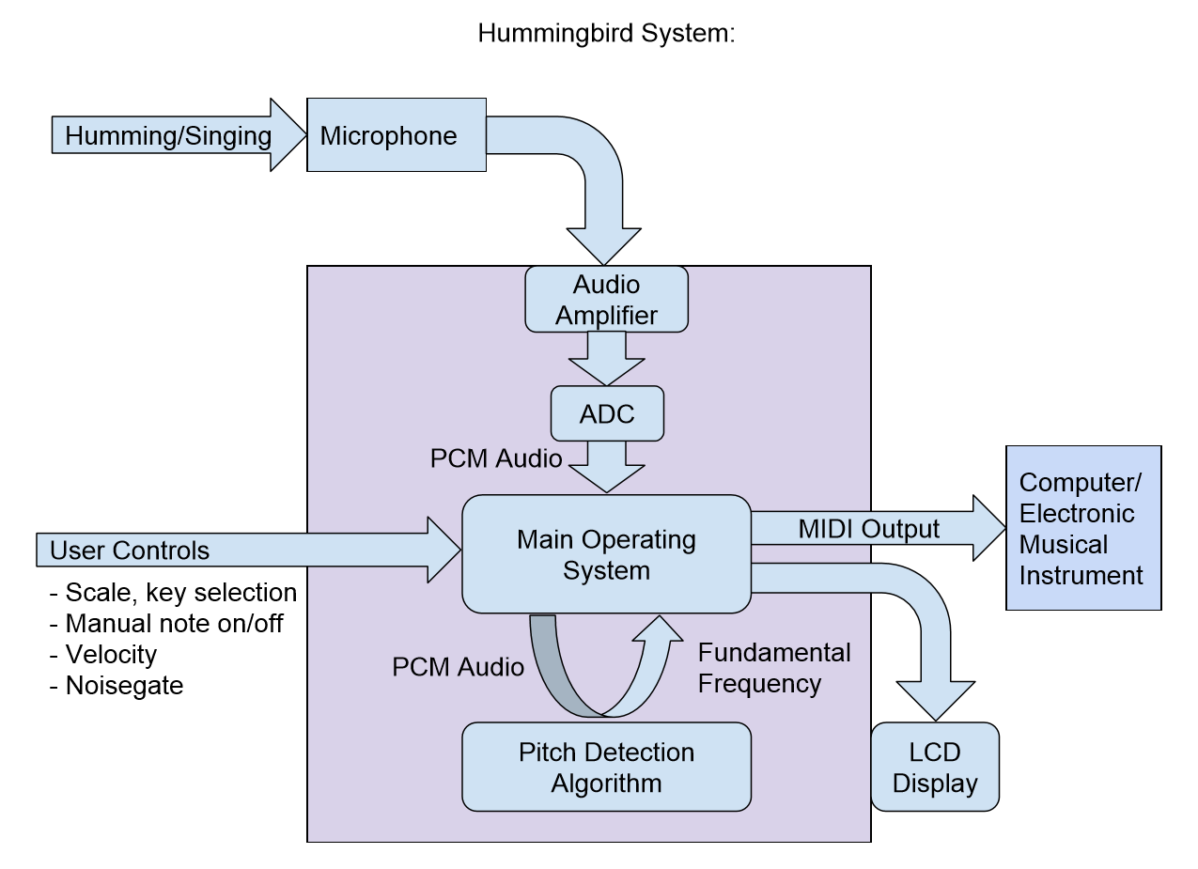
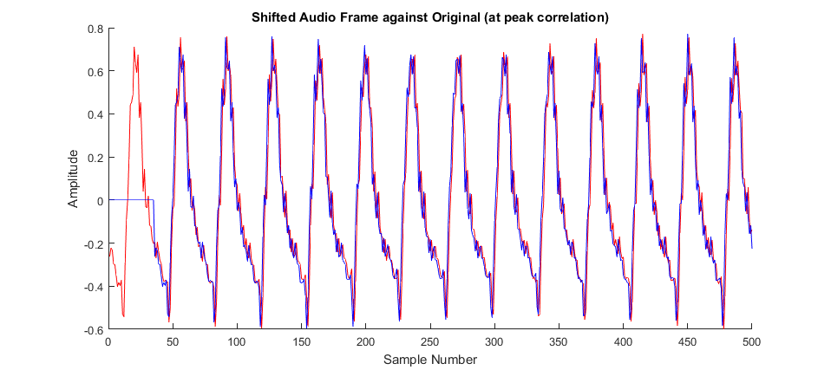
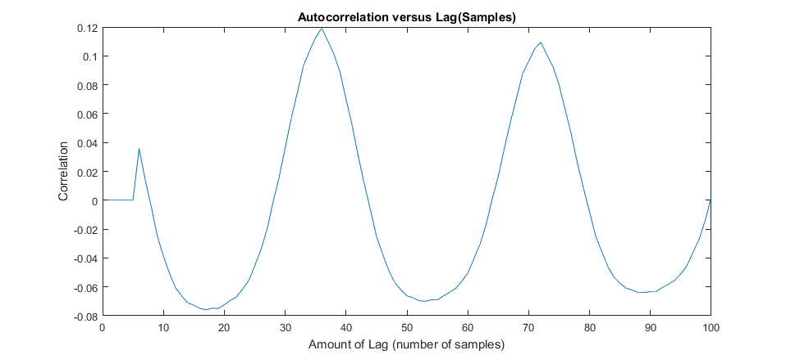
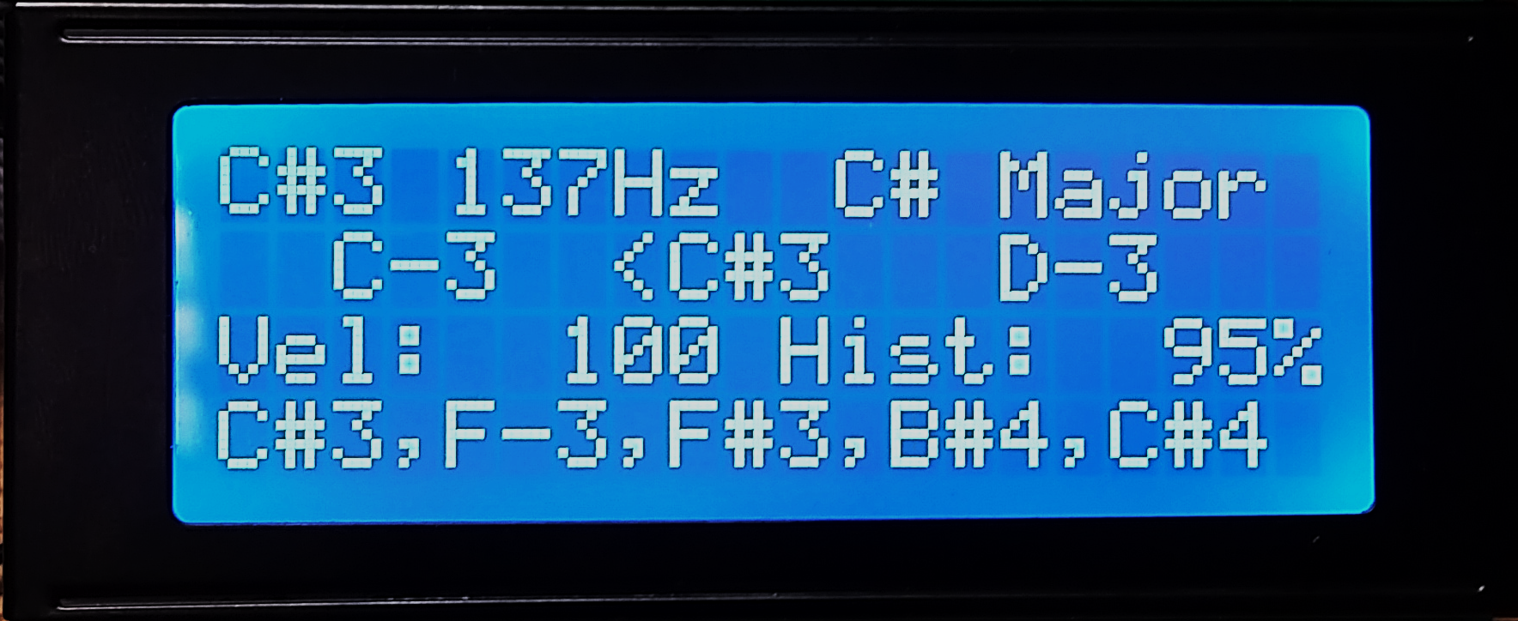
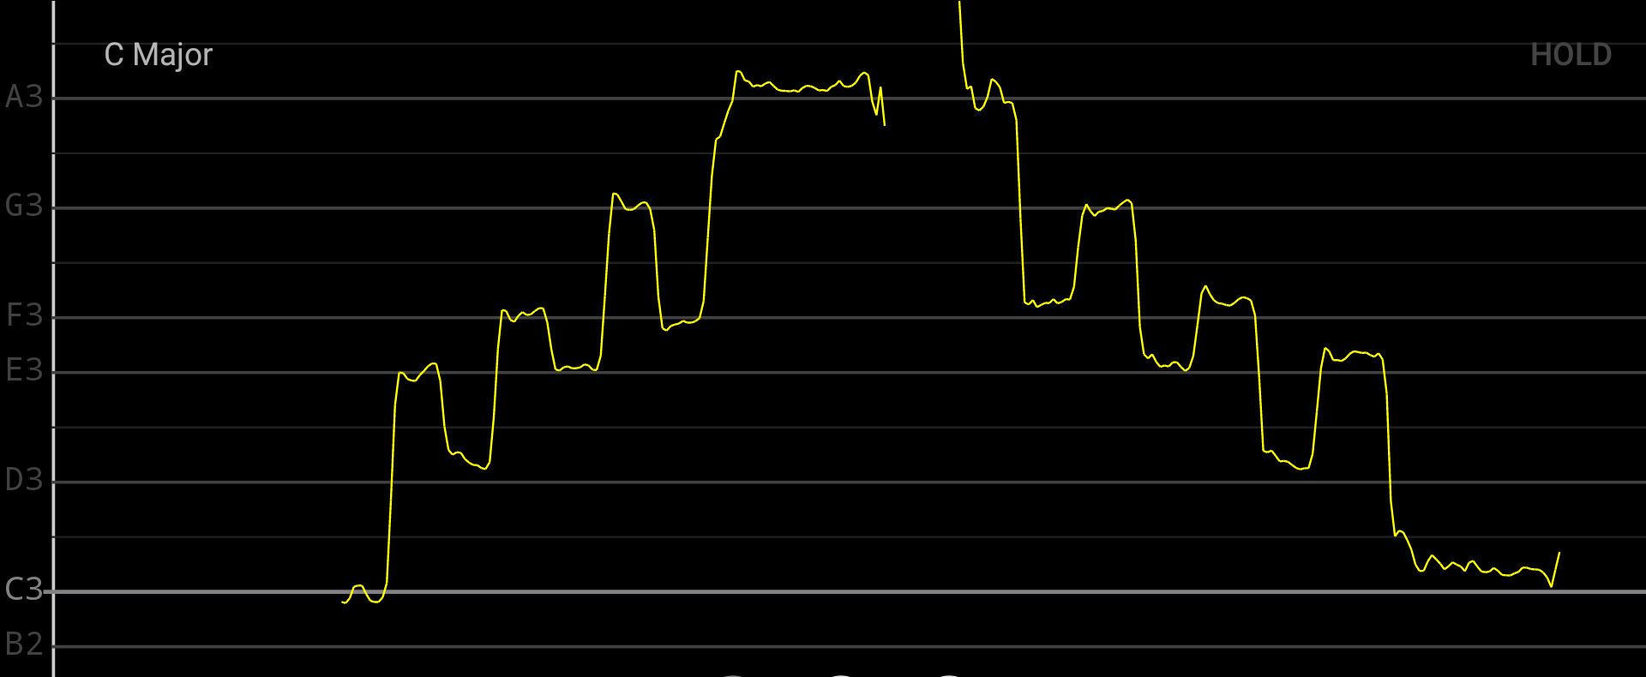
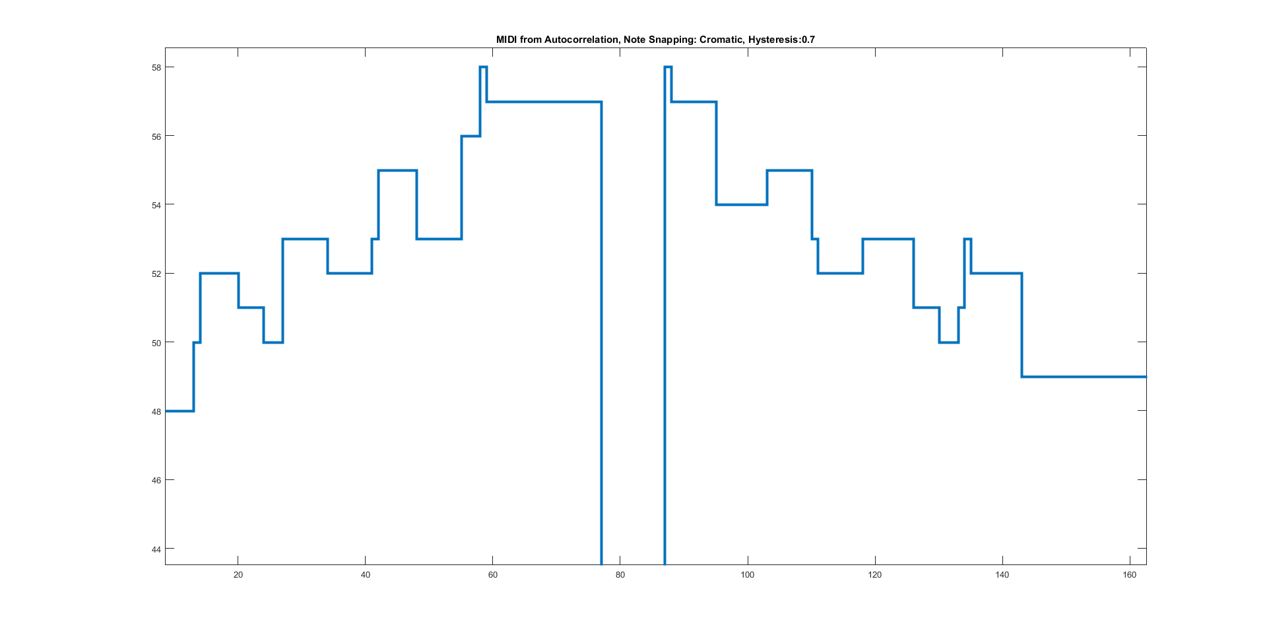
Hummingbird: Acoustic Control for Electronic Musical Instruments
Joey Devoto, Marcus Gronberg, Andre Marquez, Jason Vance
Abstract
Overview
Analysis
The Hummingbird is a music tool that allows the user to play musical instruments and compose music by humming. Instead of using hands to manually play an instrument (like striking keys on a piano), the user hums their melody into a microphone. This audio is processed using a pitch detection algorithm in real-time (less than 80ms of delay between humming the note and output). This pitch is converted into MIDI (Musical Instrument Digital Interface) data, which can be used to play any digital instrument (hardware keyboard, synthesizer) or record and play on a Digital Audio Workstation (Ableton Live, Fl Studio, etc.).
Audio data from a microphone is sampled and temporarily written into one of two buffers, which we call data frames. Data frames have a length of 256 samples, and each sample has a resolution of 12 bits. When a frame has been filled, it is passed to the pitch detection algorithm to extract the fundamental frequency (note being hummed).
To extract the musical information from this audio, we implement a pitch detection algorithm to find the fundamental frequency of each frame. This fundamental frequency (which is a single numeric data value) is passed back to the main program, which translates the frequency into its associated musical note (A3, B#4, G5, etc). This note is placed into a MIDI message, which is sent out of the system to an electronic instrument or computer with digital music software.
Pitch Detection Algorithm (Autocorrelation):
The PDA functions by comparing the original audio frame to time lagged versions of itself.
By sweeping across a set of time lagged frames, the amount of time delay that results in the highest correlation can be determined:
By dividing the sampling rate by the number of samples resulting in the highest correlation, we can determine the fundamental frequency of each frame.
Note Snapping and Hysteresis:
Output from the PDA is fed into a “note snapping” function in which pitches are restricted to a predetermined set of frequencies correlating to musical scales. Currently, the Hummingbird system is capable of processing music for the Chromatic, Major, Minor, Major Pentatonic, Minor Pentatonic, Blues, and Whole Tone scales.
To Improve the accuracy of the MIDI output, the frequency of each new frame is compared to the last, and must exceed a specific threshold before a different note is output. This hysteresis method prevents vibrato and other inaccuracies from dissociating what the user expects from the actual output.
Approach
Platform
The Hummingbird was developed on a CY8CKIT-059 PSoC 5LP Prototyping Kit, a versatile microcontroller equipped with an ARM Cortex-M3 CPU and high-precision analog-to-digital converters.
Audio Acquisition:
-Microphone Amplification:
The signal from the mic is fed into an analog amplification circuit before it is captured by the PSOC ADC. The circuit amplifies the signal to the appropriate voltage level for the ADC. this allows the PSOC ADC to read the largest signal possible, which produces a clear digital signal.
- Analog to Digital Conversion:
Analog to digital conversion of the amplified microphone signal is preformed using the onboard successive approximation ADC. This method was chosen over the Sigma-Delta ADC because the SAR method offers lower power consumption and latency.
Pitch Detection Algorithm:
The input audio is sampled at a rate of 4000 samples per second, which are processed by the pitch detection algorithm as individual “frames” of 256 samples. The fundamental frequency of each frame is processed using autocorrelation, converted into a MIDI note, and output over USB or standard MIDI port.
Note, Frequency, Key/Scale
Tuner
MIDI Velocity, Hysteresis
Previous Notes
Frequency results of an intentionally poor test performance as viewed using Vocal Pitch Monitor
Output of the autocorrelation pitch detection algorithm snapping to the Chromatic scale (all notes)
Acknowledgments
Conclusion
Project Mentor – Dr. Patrick E. Mantey
Peer Advisor – Eric Cao
Vocal Pitch Monitor – Designed by Tadao Yamaoka
Our team’s ambition is to break down the barrier between creative thought and execution. Using this system, musicians of mixed skill levels can collaborate and explore artistic ideas beyond the inhibitions of their technical dexterity. The application of this system is not limited to music production, and might be applied towards musical education as well. We hope to move the project into commercial development in the near future.

